Slide 1
Special dates
UNIT 4B

Slide 2
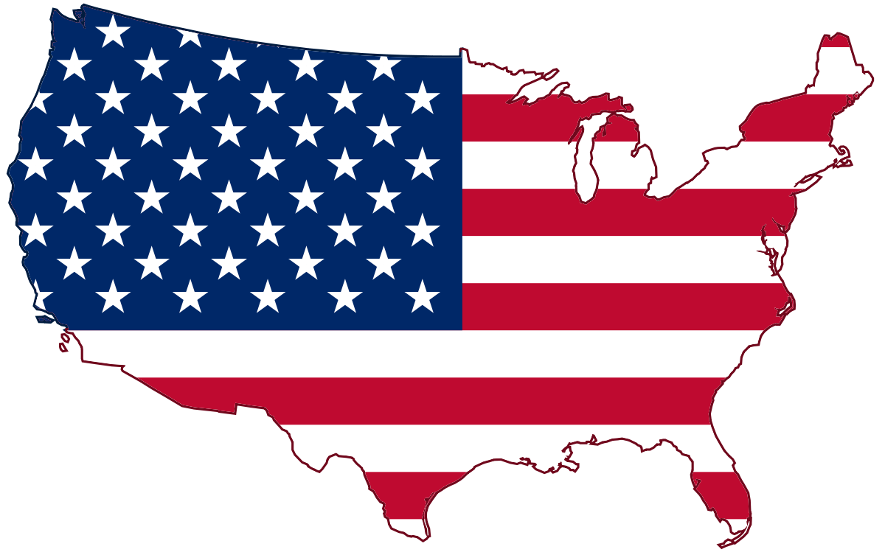
Agenda
Review: Present simple
Vocabulary: Special dates
American vs. British
Frequency adverbs
Reading: Easter

Slide 3

Learning objectives
The student will be able know more about some Special dates.
The student will learn main differences between Americans and British culture.

Slide 4
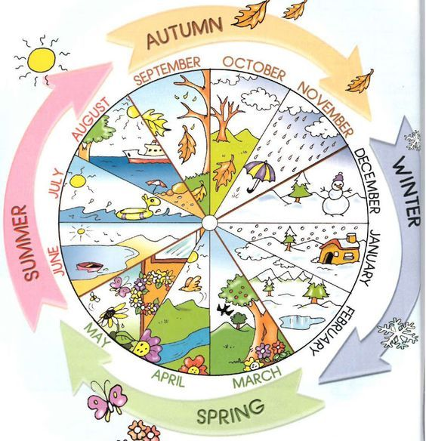

The European seasons

Slide 5
Special dates
Anniversary
Christmas
Easter
Valentine’s
Birthday

Slide 6
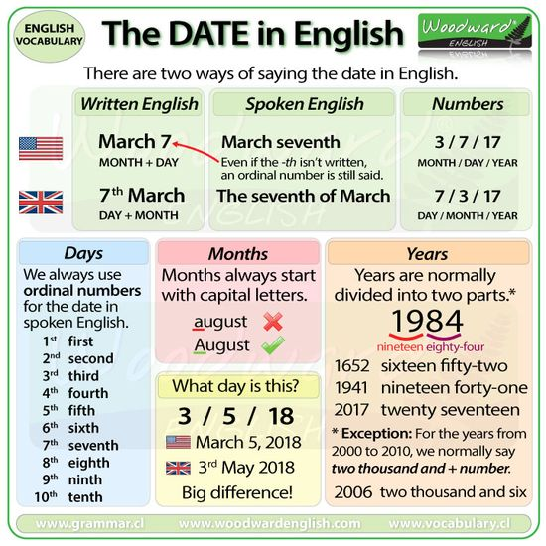
Ordinal numbers
When is your birthday?
When is Christmas evening?
When is the American independence day?

Slide 7
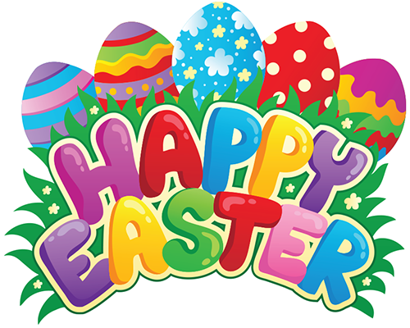
Easter
Easter ___ a Christian holiday that _________ the belief in the resurrection of Jesus Christ. In the New Testament of the Bible, the event is said to have occurred three days after Jesus was crucified by the Romans and died in roughly 30 A.D. The holiday _________ the “Passion of Christ,” a series of events and holidays that _______ with Lent—a 40-day period of fasting, prayer and sacrifice—and _____ with Holy Week, which ________ Holy Thursday (the celebration of Jesus’ Last Supper with his 12 Apostles, also known as “Maundy Thursday”), Good Friday (on which Jesus’ crucifixion ___ observed) and Easter Sunday. Although a holiday of high religious significance in the Christian faith, many traditions associated with Easter date back to pre-Christian, pagan times.
is
celebrates
concludes
begins
ends
includes
is
Missing verbs: End /Include /Be x2 /Begin /Celebrate /Conclude
History.com Editors. (2009, October 27). Easter 2021. History.com. https://www.history.com/topics/holidays/history-of-easter#:~:text=Easter%20is%20a%20Christian%20holiday,the%20resurrection%20of%20Jesus%20Christ.&text=Although%20a%20holiday%20of%20high,pre%2DChristian%2C%20pagan%20times.

Slide 8
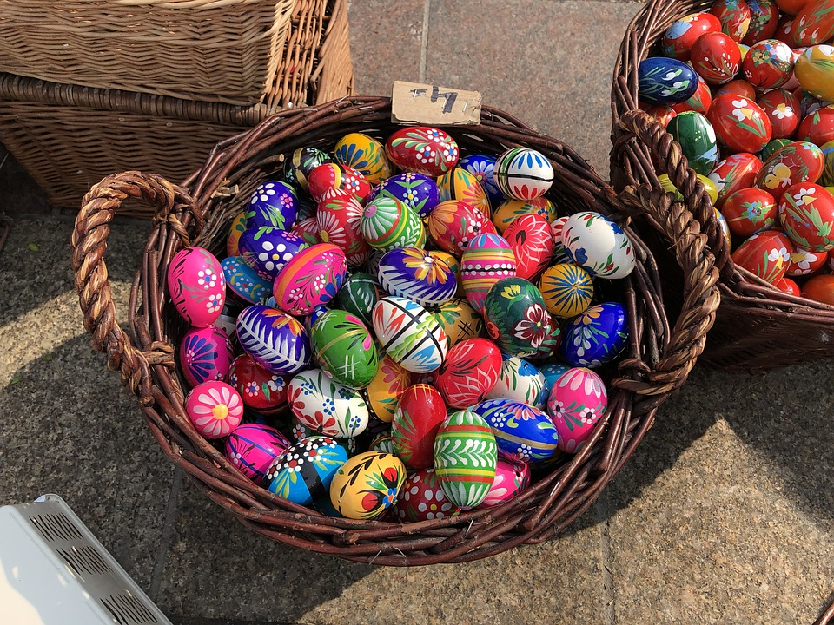
Easter: True or false
Many traditions associated with Easter date back to pre-Christian, pagan times. _____
Holy Thursday is related which Jesus’ crucifixion is observed. _____
Easter is a Christian religious holiday to celebrate Jesus Christ’s return to life after he was killed. _____
The week before easter Sunday is the Holy week. _____
The death of Jesus Christ on a stick was the crucifixion. _____
Eggs represent the new beginning for the humanity after Jesus' death. _____
Rabbits are a symbol of new life. _____
True
False
True
True
False
True
True

Slide 9
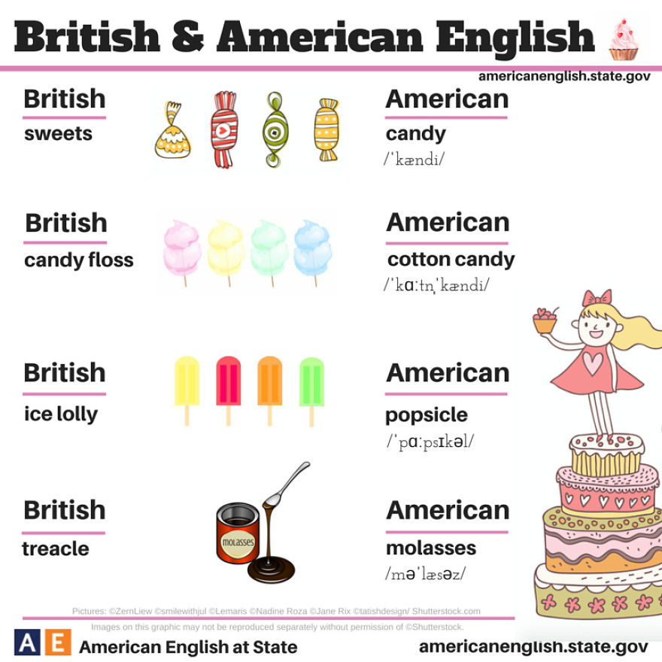
British vs. American English
A thick, dark brown liquid that is produced during the process of making sugar, used in cooking…
Treacle /Molasses

Slide 10
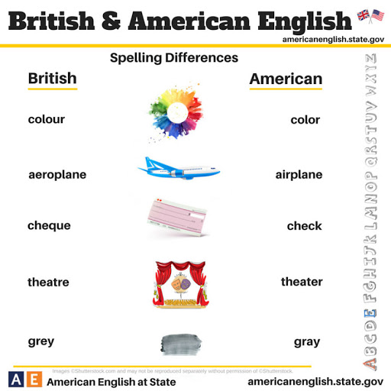
British vs. American English
A vehicle designed for air travel that has wings and one or more engines…
Aeroplane /Airplane

Slide 11

20 words Brits and Americans say differently

Slide 12
A?
B?
C?
D?
E?
F?
Comprehension task
Water
Tomato
Adult
Advertisement
Either
Schedule
Mobile
Address
Massage
Fiancè

Slide 13
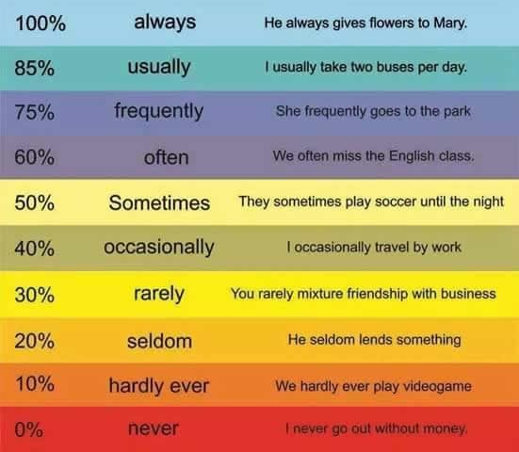
Adverbs of frequency
How often do you travel?
How often do you go to the theatre?
How often do you eat sweets?
How often do you buy a popsicle?

Slide 14
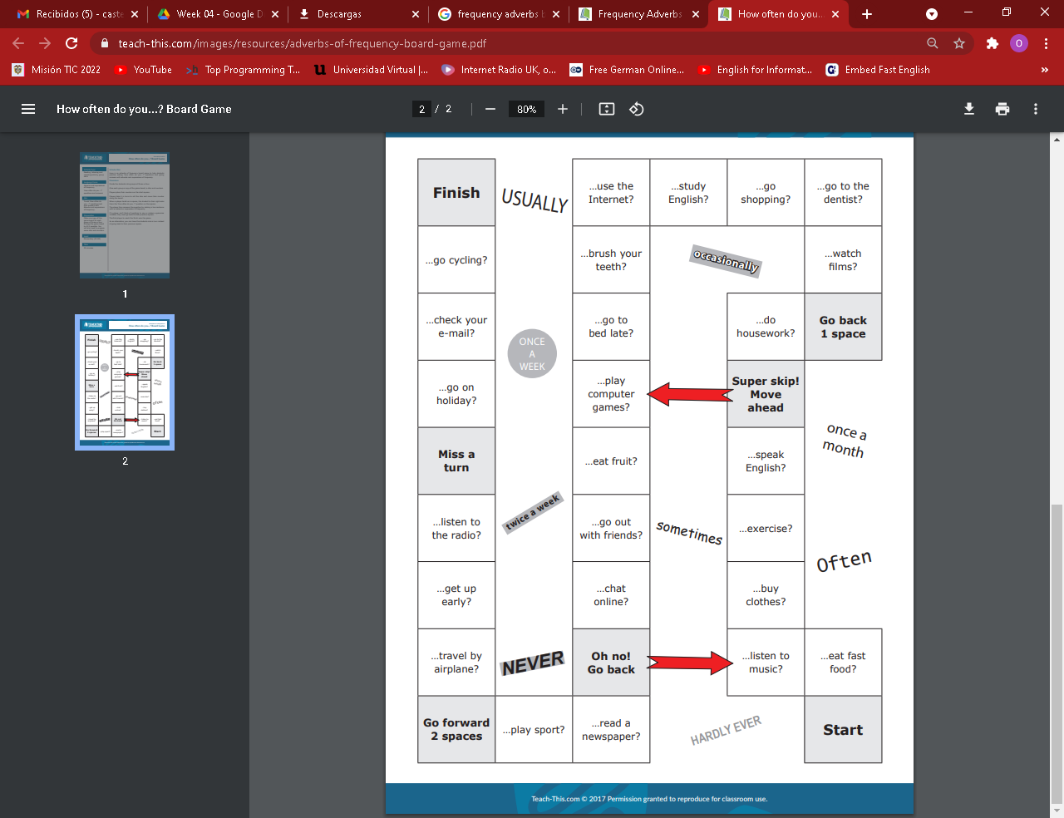
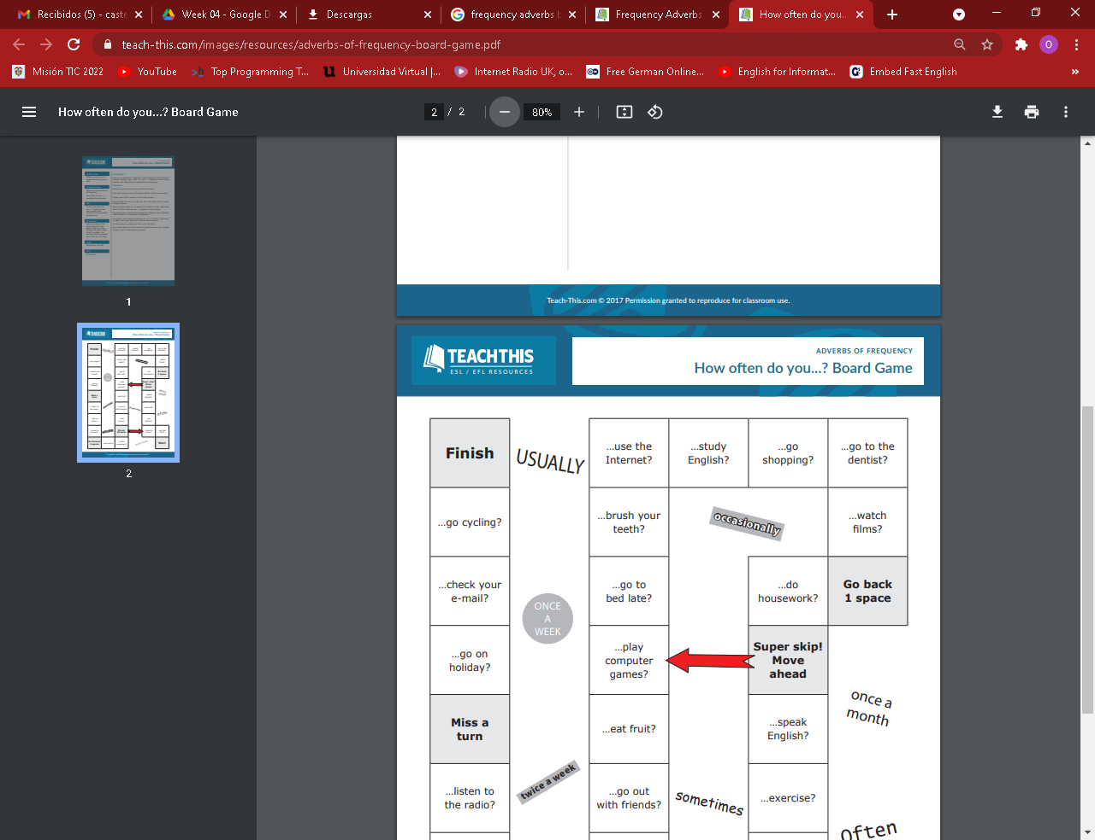

Board game

Slide 15
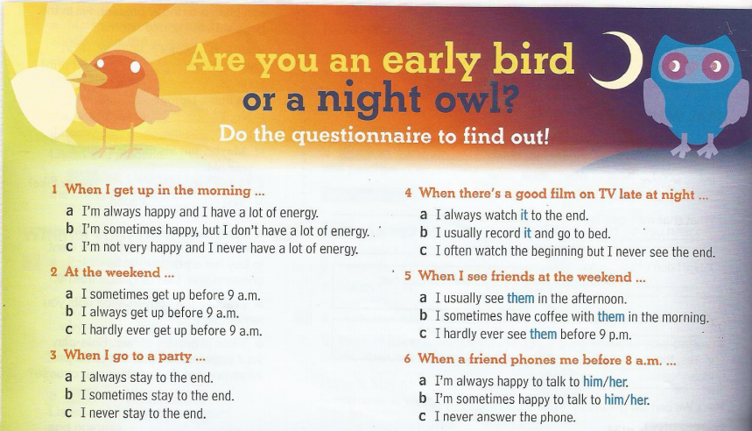
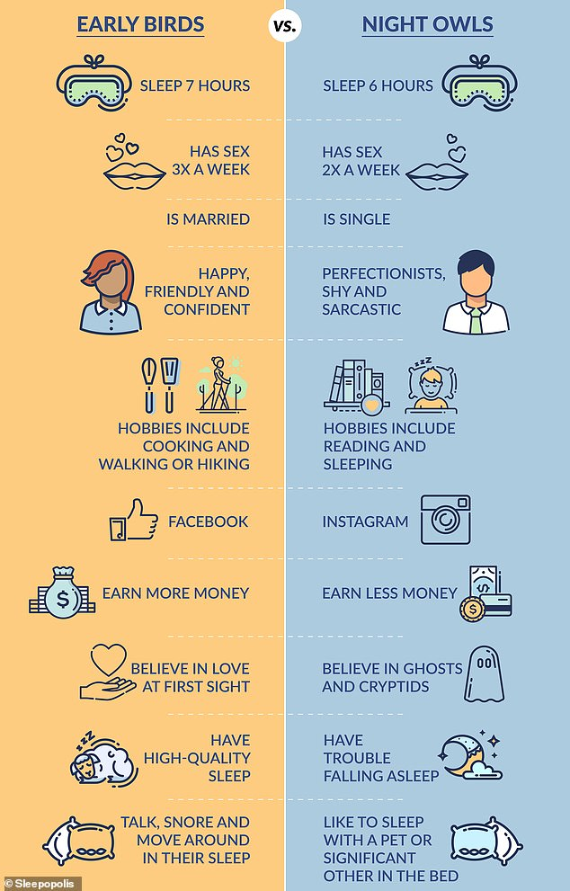
face2face Elementary: face2face. Cambridge University Press. (n.d.). https://www.cambridge.org/ec/cambridgeenglish/catalog/adult-courses/face2face-2nd-edition/face2face-elementary-2nd-edition-students-book-online-workbook.

Slide 16
Listening
Vocabulary
Eat sleep dream English by Tom
Wordshake
English tips

Slide 17


